Slide 1

TEAM TECHNO-SPARK EFFORTS: Rutika Bhakre Shital Swami Shraddha Kakade Sristi Prasad Suyash Awathe
H-SOCIAL CREATOR COMPETITION
ENVIORNMENT INNOVATION

Slide 2

BUSINESS NEED / OPPORTUNITY
WHAT IS BUSINESS PROBLEM ?
Horns in our country emanate noise as high as 110 decibels (dB). This is above the safe limit suggested by the World Health Organization (WHO), which cautions that long-term exposure to noise levels from 85db to 90db can lead to hearing loss.
In India, the problem of noise is not related to sound level emanating from horns, but very frequent and unnecessary honking on the roads. Indian road conditions are also responsible for heavy horn usage, as there is a lack of driving discipline.
Fortunately, we have discovered new, more efficient, way to cope up with the noise pollution persistent in the country. We thought of an idea where people can use mobile-based alert/honking application that replaces the traditional noisy honking systems in the 4-wheeler automobiles.

Slide 3
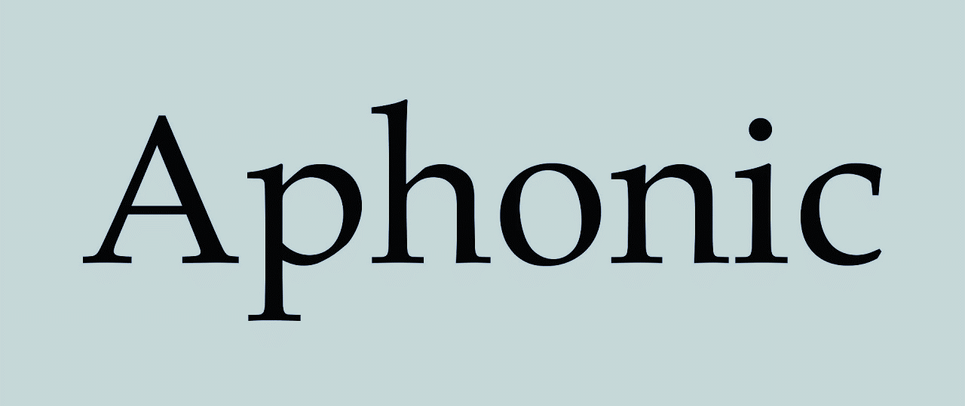
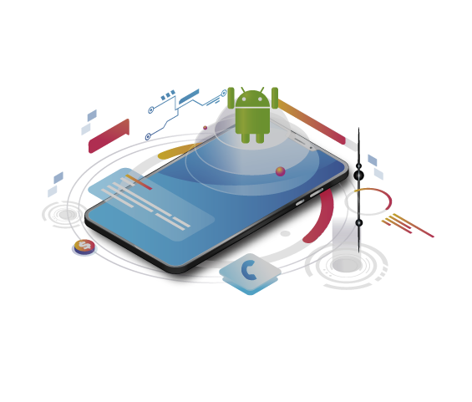
Our proposed project would revolve around an android/IOS based mobile application software prototype that initiates a dual way horn communication between two drivers.
The application will access the location, through GPS tracking and will show the position of nearby vehicles using the Maps Functionality.
The software will be interfaced with an external horn button, positioned in the car with easy accessibility to the drivers.
Introduction

Slide 4
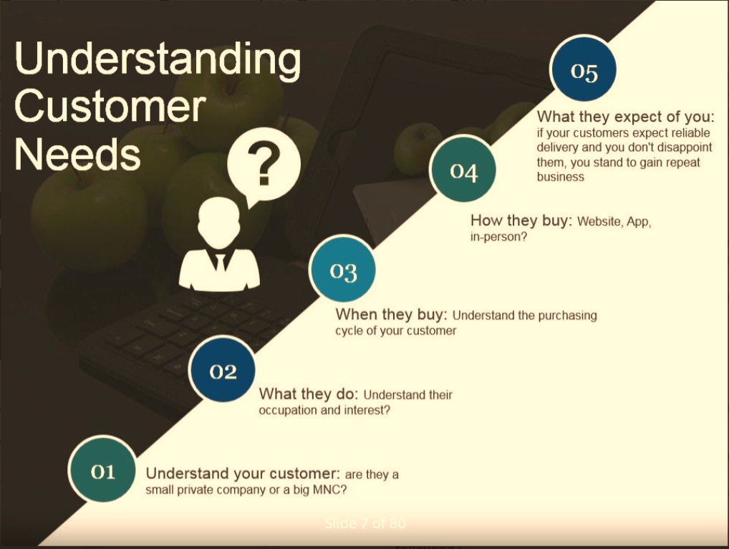
What customers expect from us?
Portable and long-standing system.
Why it is important for us to address this need?
To reduce the most prominent environment hazard in the country and to ensure a comfortable and peaceful ride for everyone.
Is it affordable?
With all the features included, this product under no-cost can provide service to the end users.
What unmet needs does it serve?
More environment friendly than the traditional noisy horns existing in today’s market.
Who are the intended customer?
Apt for 4-wheeler vehicle owners, who want to adopt to a no-horn policy.

Slide 5

How is aphonic superior and beneficial to the end users ?
Since aphonic is a software-based mobile application, it saves the overall costs invested in making a physical electronic horn installed in vehicles.
Aphonic is an easy to understand application that requires only basic internet connectivity to work.
Aphonic operates within a specified radius and targets vehicles present in that vicinity, reducing unnecessary clangor.
It requires minimum disk space in a smartphone. Aphonic does not collect the personal data of users for any third party use. Therefore aphonic works on an end-to-end encryption.

Slide 6
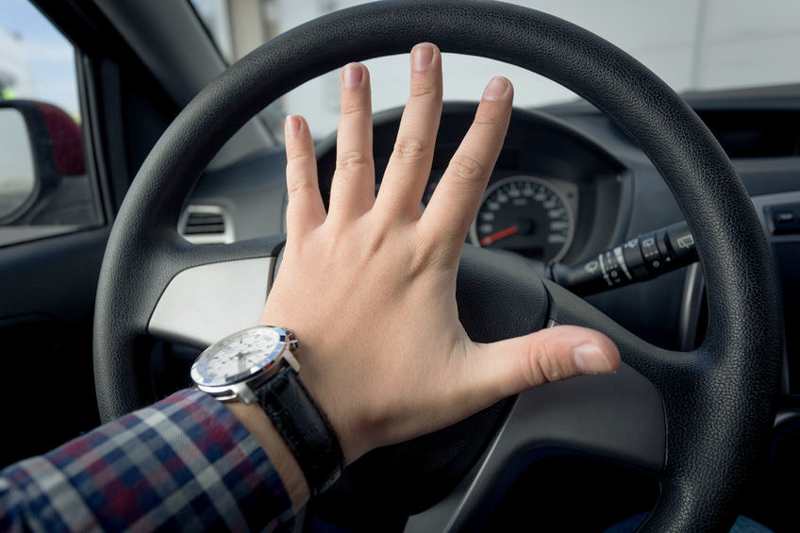
Traditional Vehicle Horns VS Aphonic
In contrast to the integrated honking systems in 4-wheeler automobile that produce high sounds of up to 107-109 decibels, aphonic produces alert ringtones that range between 60- 76 decibels.
Here is how aphonic is a unique and alternative solution:
Produces less noise pollution.
Restricts the habit of unnecessary honking.
A better and a civilised solution.
Works on any decent smartphone.
Eradicates health problems occurring due to prolonged exposure to honking noises.
Cost efficient and no requirement of heavy electronic infrastructure.

Slide 7
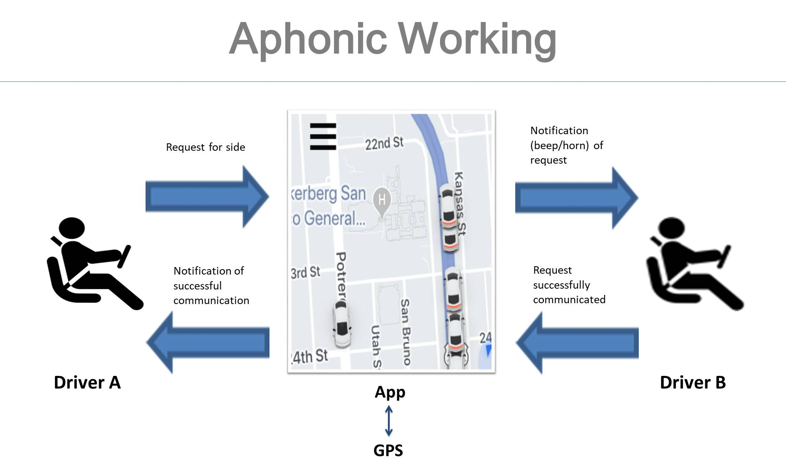
Working of Aphonic:
→ In order to use the application, users need to register themselves and validate their account by providing personal as well as vehicle details.
→ The application will access the location, through GPS tracking and will show the position of nearby vehicles using the maps functionality.
→ When a driver hits the horn button external to the application, signals shall be transmitted through the Aphonic Application of driver to the Aphonic Application of nearby drivers.
→ An audio alert/ringtone identical to a horn shall be heard from the application by the drivers.
→ Once the audio is perceived by the targeted driver, the dots indicating vehicles on the map shall turn green, as an acknowledgement of request received.
→ A driver can send as well as receive multiple horn signals to different drivers simultaneously.

Slide 8
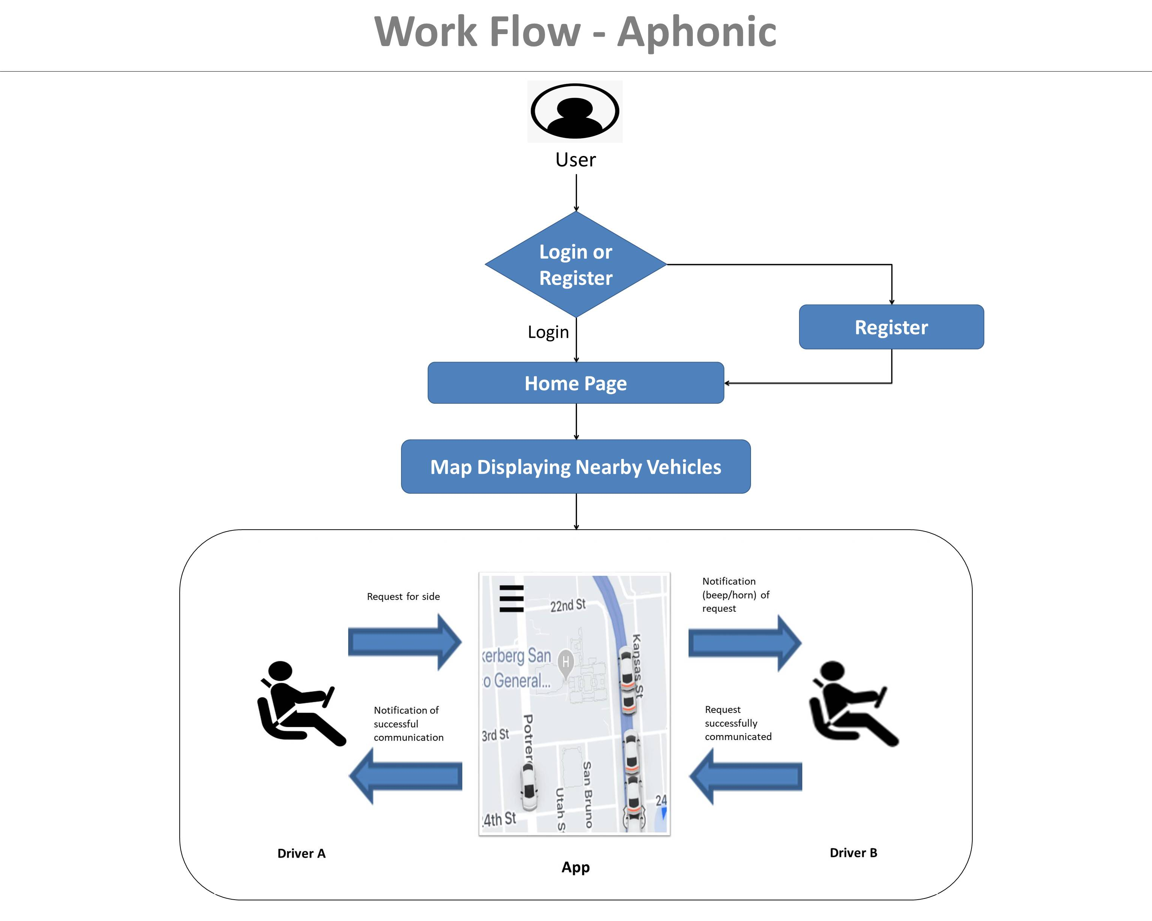
Registration Functionality
This helps new users to access the application by successfully completing authentication.
Login Functionality
Login functionality will help in validating a user.
Location Accessibility
The application access GPS and internet connectivity throughout its usage for live tracking of vehicles.
Maps Functionality
Maps will help users to navigate as well as recognize nearby vehicles registered on application.
Messaging/Notification Functionality
This functionality will help in successfully sending and receiving notifications/requests form drivers/application-users in vicinity.
Helpline Details
Helpline will provide contact details during distressful situations , specific to user’s location.
Functionalities in Aphonic:

Slide 9
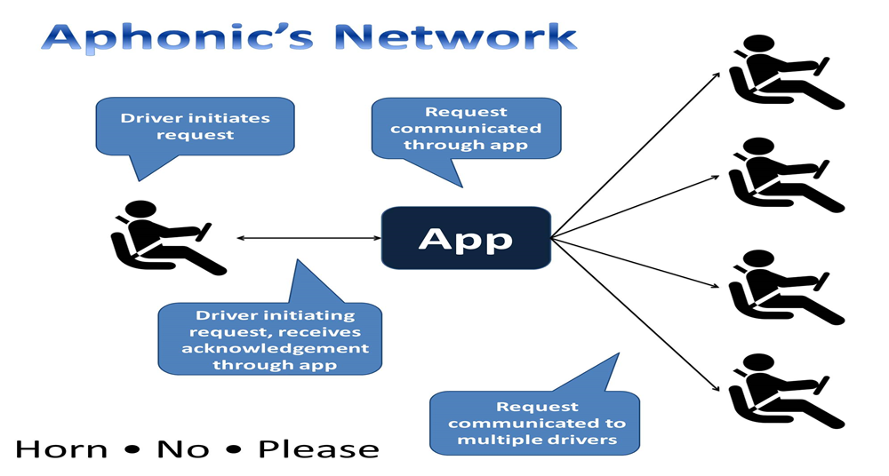
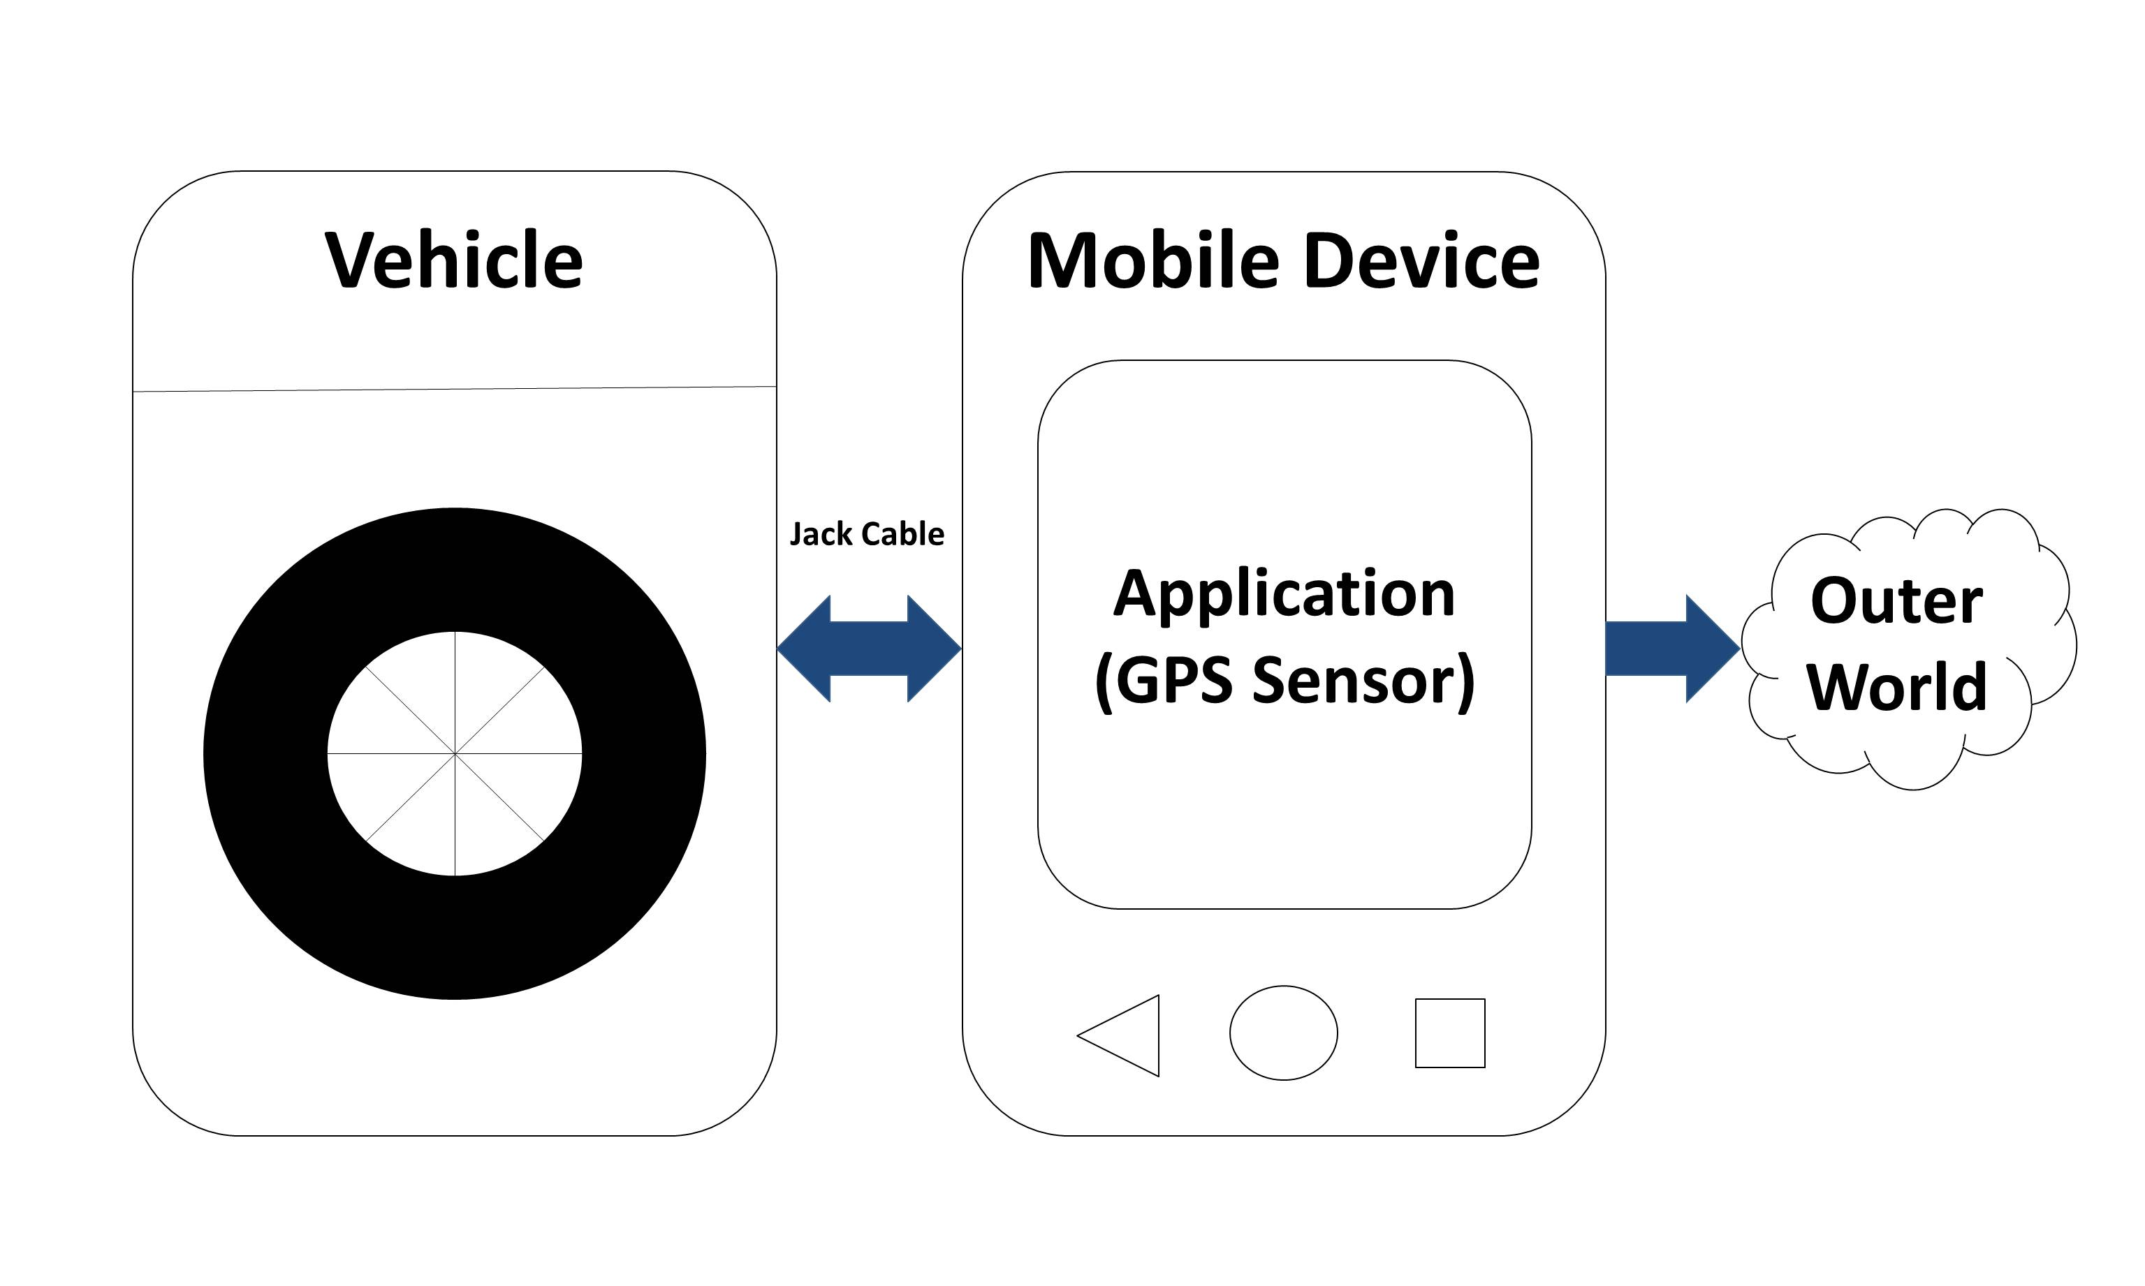
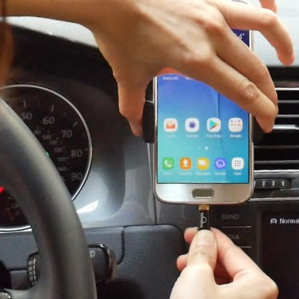
9

Slide 10

TECHNOLOGY STACK
FRONT-END
BACK-END
SERVER
XML
JAVASCRIPT
KOTLIN PROGRAMMING
DART PROGRAMMING
SWIFT PROGRAMMING
USED FLUTTER FOR ANDROID AND IOS APPLICATION
GOOGLE MAP API
BLUETOOTH APIs
POSTGRESQL
DISTANCE MATRIX API
Application Hosted on Heroku server.
For Storages FIREBASE.

Slide 11

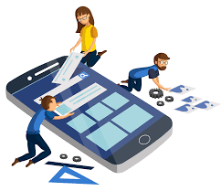


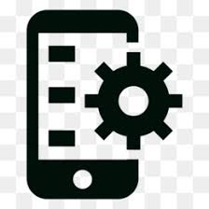
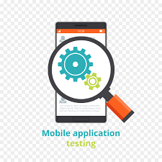
Project Timeline
2 weeks
4-5 weeks
1 week
Conceptualizing
UX Design
Testing
Planning the
development
App development
Launching
1-2 weeks
2 weeks
1-2 weeks

Slide 12
Project Timeline
Begins with Client Brief
Researching the Market
Capturing and brain-storming every applicable idea
This stage can last for around 15 days
Decision of what features we want to include in app
Complexity of the features will determine the cost & timeline.
This stage can last for about 2 weeks on an average.
The UX is arguably one of the most important facets of the app and can determine whether users enjoy using the app or decide to uninstall it.
It can take anywhere between 15-20 days
The front-end refers to development of the app for user interaction
Backend involves the server side development of the app.
This process will account for the most number of days (4-5 weeks)
App needs testing to identify & resolve any bugs before they hamper a user’s experience.
Testing will be done to check if the app’s features are working properly
May need 1-2 weeks
Once the app is ready, it can be officially launched into the Google Play Store and Apple Store
Launching the app will require only about one week.
Conceptualizing
Conceptualizing
Planning the
development
UX Design
App development
Testing
Launching

Slide 13
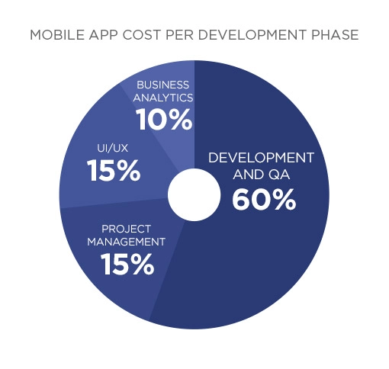
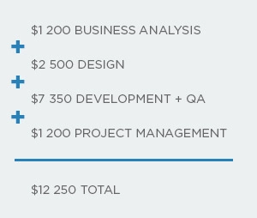
Project Budgeting
Cost of Business Analysis in App Development Budget : $1,200 to $11,000.
Cost of Design and Clickable Prototype in App Development Budget : $2,500 to $10,000.
Cost of App architecture & functionality development : $2,000 to $60,000.
Cost of Project Management in App Development Budget : $1,200 to $12,000

Slide 14
GO-TO MARKET PLAN
Target Market Audience
4-wheeler licsened automobile owners between the age group 18-60 years
Professionals navigating in automobile cars to destination in busy traffic-affected cities.
Brand Positioning and Digital Marketing
Executing well-defined promotional strategy of Aphonic App through social media platforms and awareness events.
Market Strategy
Track and Measure
Measuring and tracking app engagement through number of downloads and growing customer base
Value proposition
Concise sign-in process
Freemium version that indirectly monetizes the app.
Advertisement positioning that does not disturb users app tour.
Secured and encrypted customer information.
Increasing Customer Engagement
Through simple functions, improved UX/UI and hands-free operation.

Slide 15
Percentage of automobile owner
Aphonic-the muted horn is estimated to rise in the global market with its no-horn policy essence by 2023 and is expected to retain its dominance throughout the forecast period.
Years forecast
15

Slide 16
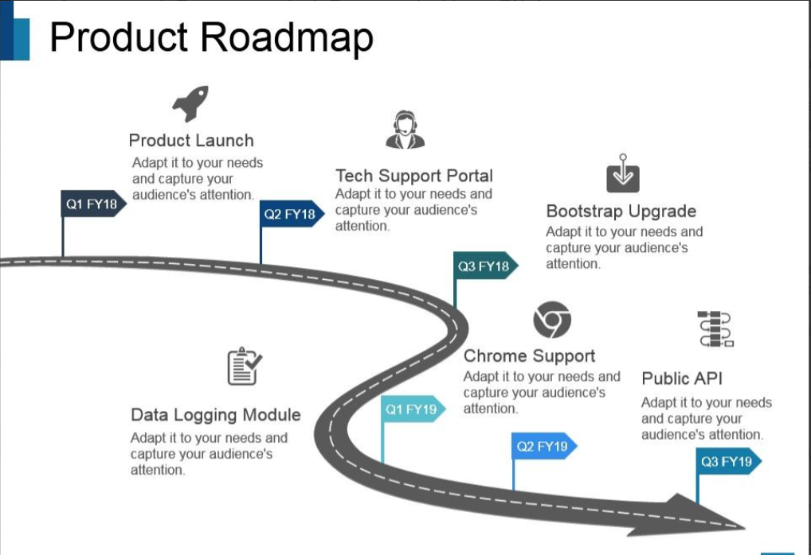


Business Impact / Measure Of Success
SERVICE ORIENTED ARCHITECTURE (SOA)
Product Launch
Helps to initiate noise-free driving experience..
Tech Support Portal
Services will be provided at any time if there is any technical fault in the app.
Bootstrap Upgrade
It will download latest updates as soon as a software is upgraded.
App Support
It will support android as well iOS.
Public API
It will help to interact between multiple softwares.
Data Logging Module
It will keep all the record of your data securely.

Slide 17
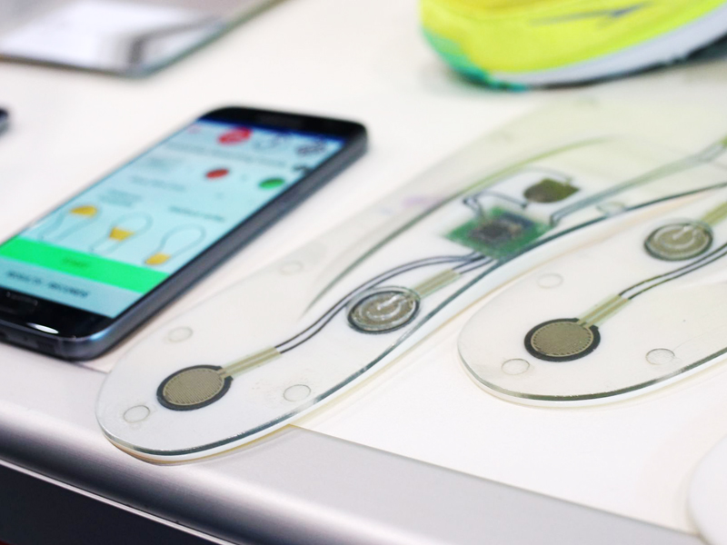
PRODUCT SERVITIZATION
Industry Outlook
App development INDUSTRY BUSINESS SERVICE PROVIDER
SELLING NEW PRODUCT CAPABILITIES VIA APP UPDATES
UNBURDENING CLIENTS FROM bulky application integrations
SUBCRIPTION BASED PREMIUM FEATURES
DEBUG, MAINTAINANCE, HELP-DESK, HOTLINE
LEADS TO CONTINUOUS REVENUE SYSTEM

Slide 18

Thank you
MANUVER IN PEACE WITH APHONIC

